Slide 1


YOUR ONE STOP DESTINATION FOR AI & ROBOTICS

Slide 2
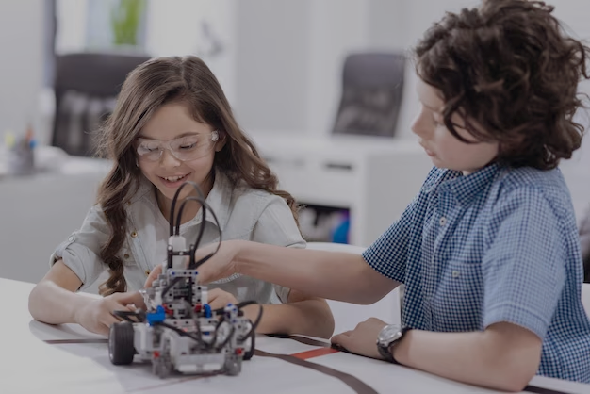

You will Learn from Us
Coding
Fundamentals of AI
Hands on IoT & Robotics
Maths
Effective Communication Skills
Ethical Awareness

Slide 3

Unleash Your Inner Genius with Our Math Hacks
Vedic Mathematics
Quick Calculation Tricks
Enhanced Number Awareness
Applying Maths to Real World Problems
Visualizing Mathematical Concepts
Focus & Confidence Boost

Slide 4
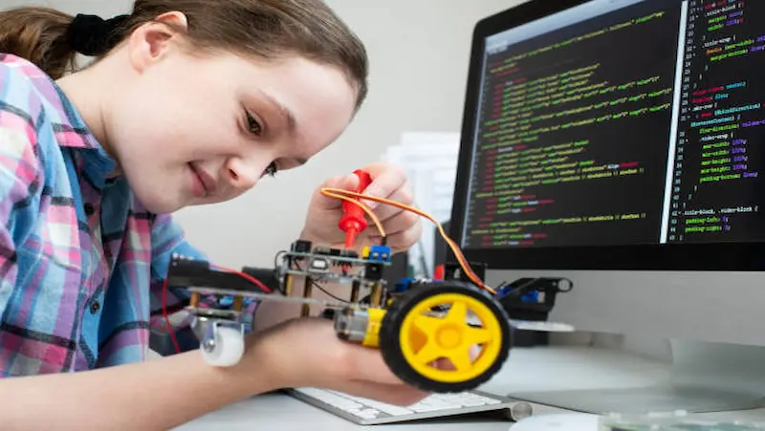
Be a Tech Wiz with Our IoT & Robotics Courses
STEM Concepts
Creativity
Problem Solving
Programming & Logic
Industrial Flavor
Internet & Cloud

Slide 5
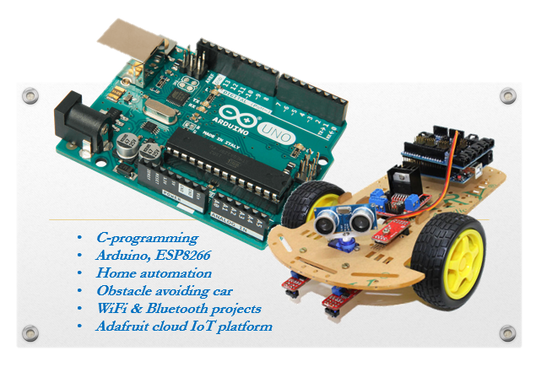
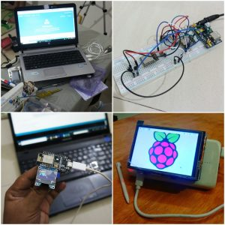

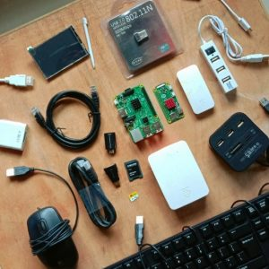
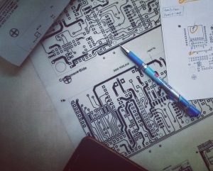

Slide 6
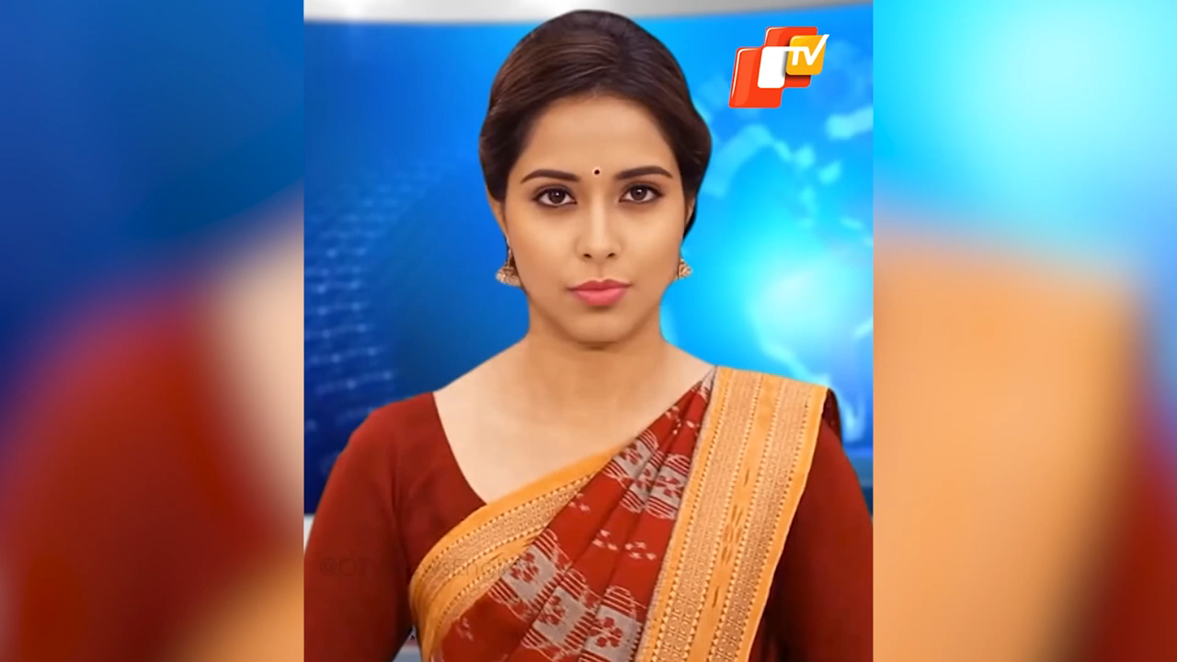
Lisa

Slide 7

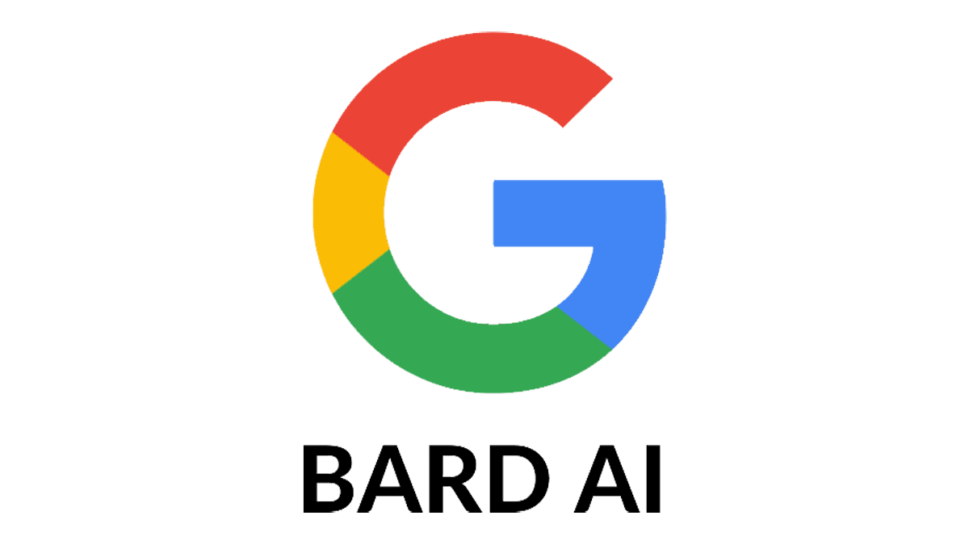



Unveil AI with Anodiam
ChatGPT is just the tip of an iceberg!
Dive deeper with us & be the next AI expert
Creativity
Machine Learning
Mathematics
Neural Networks
Statistics
Deep Learning
Coding
Data Science

Slide 8

Become A Speech Maestro with Our Groomers
Leadership
Teamwork
Confidence Boost
Social Integration
Empathy
Interview & Presentation Skills
Corporate Etiquettes

Slide 9
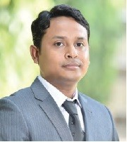
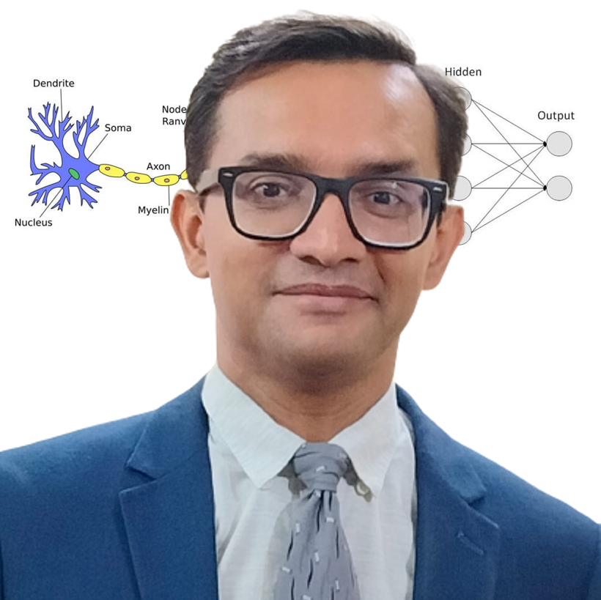
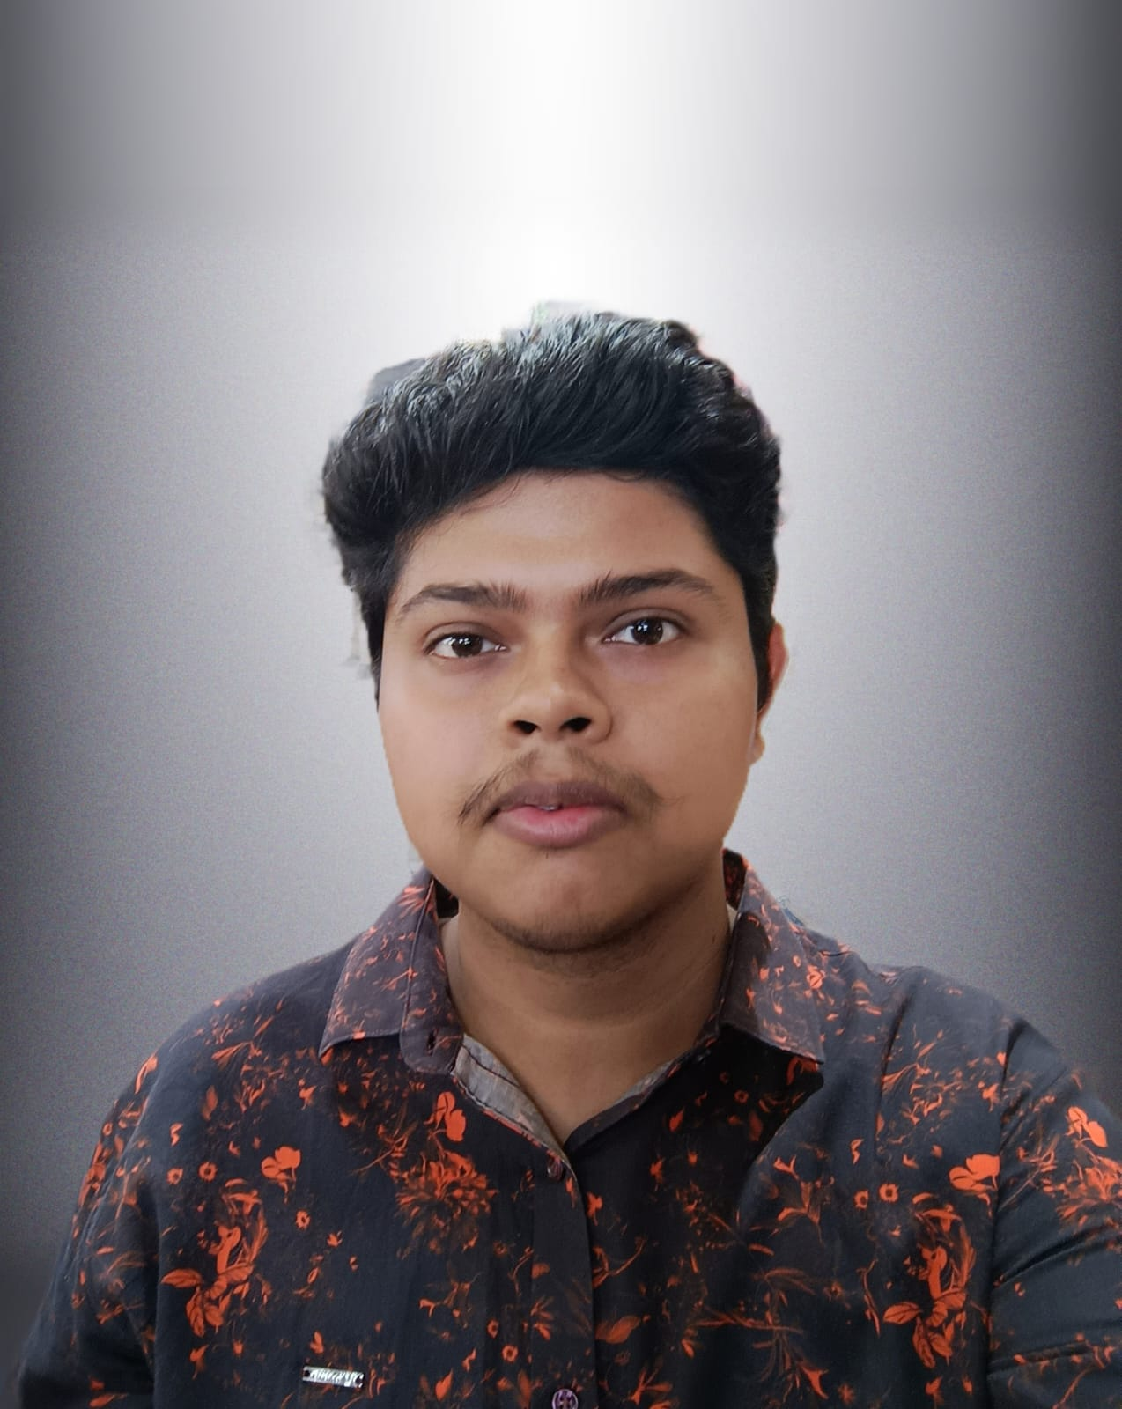
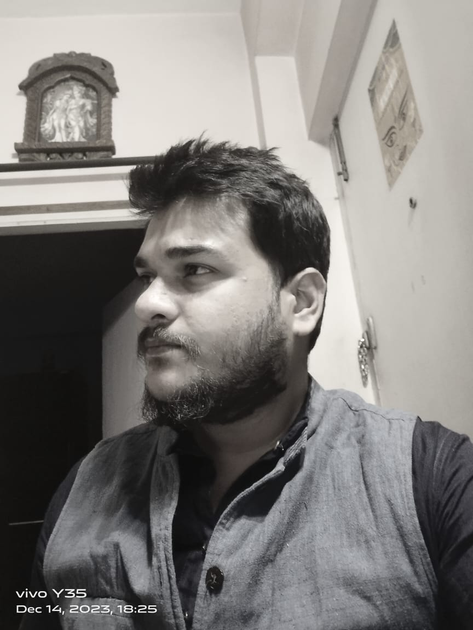
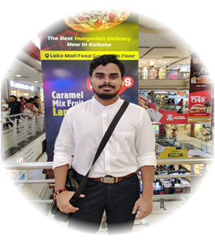
Thanks to Our Speakers
Bappaditya Debsingha, IoT Product Manager, TCS, 18 years of global experience in Robotics
Anirban Chakrabarty, C.E.O. of Anodiam, 24 years of experience in IT, Corporate grooming & AI
Sayan Basak, AI Mentor at Anodiam, 2 years of experience in Automation Industry, Electrical Engg. (B.Tech)
Rahul Dutta, English Mentor at Anodiam, 8 years of teaching experience, M.A DRS (English) from C.U.
Avishek Adhikari, Maths Mentor at Anodiam, 8 years of teaching experience, Research Scholar at ISI

Slide 10



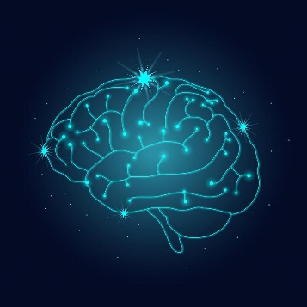




AI PROFESSIONALS ARE THE MOST SOUGHT AFTER WORLDWIDE

